Slide 1


Software Design & System Design
Basic Principles of System Design
Otávio Santana, Founder
otavio@os.expert

Slide 2
Introduction
Topics on this class
Tiers vs layers
System components: front-end, back-end, databases, caches
Scalability: vertical vs horizontal
Availability and consistency: CAP theorem and trade-offs
Latency and throughput: how to optimize both
Documentations

Slide 3
Layers vs Tiers in System Design
Understanding structure from logic to deployment
Era | Layering Pattern | Tier Pattern
1970s | Monolith | 1-tier (mainframe)
1990s | UI + logic in client | 2-tier
2000s–2010s | UI, business, DAO layers | 3-tier
2010s+ | Clean/hexagonal architecture | N-tier (cloud, microservices)
Layers organize software logically. Tiers organize software physically.

Slide 4
Tiers and Trade-offs in System Design
More tiers mean more power — and more complexity
📌 More Tiers Mean... | Pros | Cons
Separation of concerns | Easier to scale and secure each responsibility | Requires orchestration and interface design
Client-side computation (e.g. SPA) | Faster UX, lower backend load | Logic duplicated across tiers (risk of inconsistency)
Isolation of failure | One failing tier doesn’t crash the whole system | Requires retries, circuit breakers, fallback strategies
Cross-tier communication | Enables service-oriented design | Introduces network latency and serialization overhead

Slide 5
What Tiers Impact in System Design
Strategic considerations behind every deployment boundary
Shape Architecture Style
Team Structure
Security Zones
Complicate Deployment & DevOps
Client as a Tier
Cost and Cloud Billing

Slide 6
What Layers Impact in System Design
Abstraction vs Complexity — trade-offs behind logical separation
More Layers Mean... | Pros | Cons
Separation of concerns | Modular, cleaner architecture | Risk of overengineering and scattered logic
Better testability | Isolated unit tests, easier mocking | Increased complexity in integration
Team alignment | Layers map well to team boundaries | Can cause delays if coordination is poor
Infrastructure flexibility | Swap DBs, queues, or APIs more easily | Requires discipline to avoid leakage across layers
Abstraction and reuse | More reusable and general-purpose logic | Adds latency and overhead to simple operations
Notes:
Layers offer design clarity — but like all clarity, it comes at the cost of complexity and performance

Slide 7
What Layers Impact in System Design
Strategic considerations behind every abstractions
Separation of Concerns
Better Testability
Abstraction and reuse
Clear terminology
Performance
Cost and Cloud Billing

Slide 8
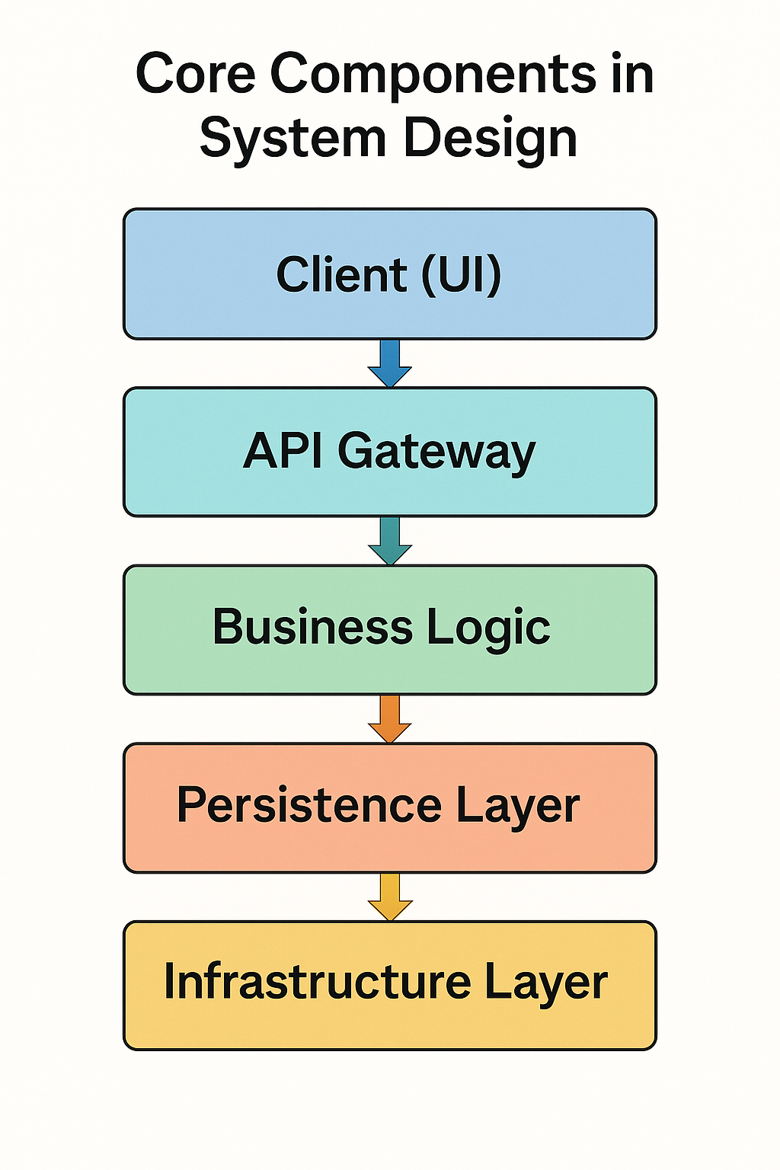
Core Components in System Design
The fundamental building blocks of scalable systems
It is a modular part of a system that:
Encapsulates specific behavior or logic
Has a well-defined interface (how others interact with it)
Can be independently replaced, reused, or deployed (depending on design)
Any unit with a clear boundary and contract
Notes:
System design starts by identifying components — and making sure each one has a clear responsibility, interface, and contract.

Slide 9








Types of Components in System Design
Understanding how responsibilities are modularized
UI
Service
Infrastructure
Integration
Persistence
Domain
Messaging
Operacional
Notes:
System design starts by identifying components — and making sure each one has a clear responsibility, interface, and contract.

Slide 10
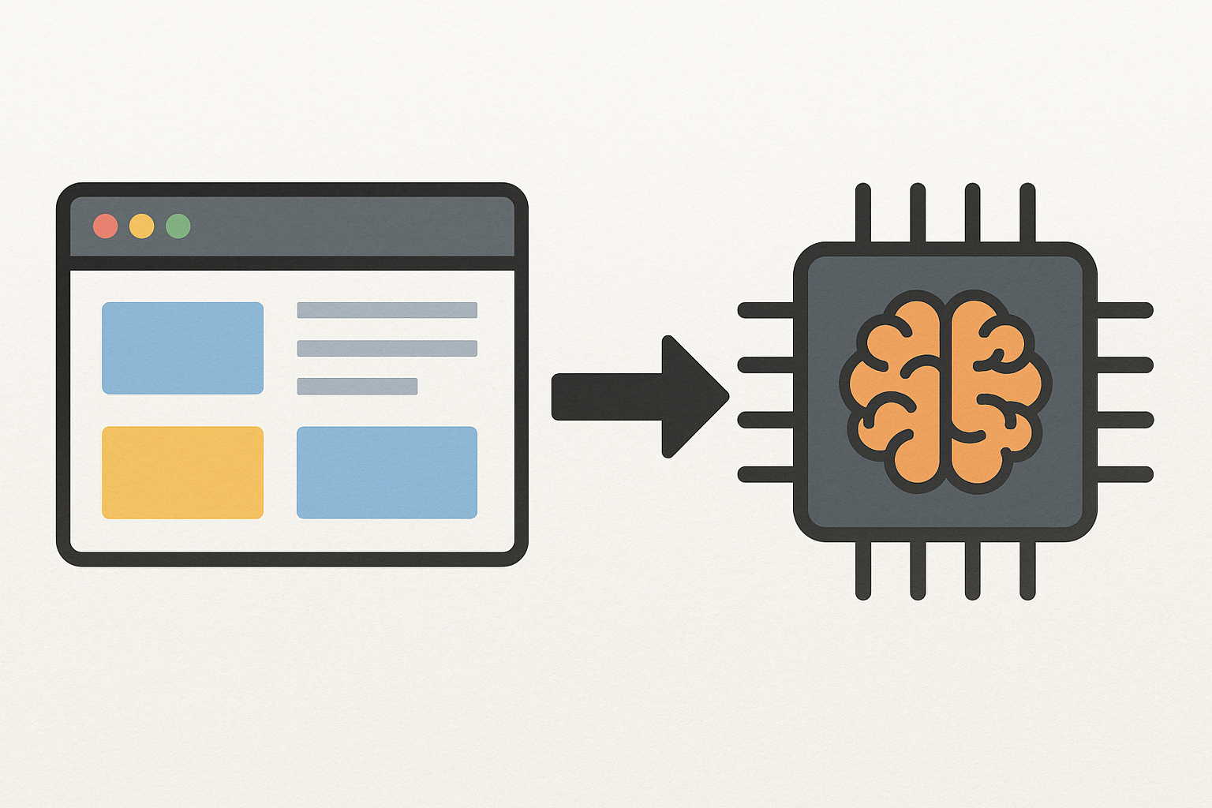
The Frontend in System Design
Where humans meet the system
Interface Between People and the System
View Logic, Not Business Logic
Often Stateless and Lightweight
Frontend Deployment
End-user Experience Depends on It
Notes:
System design starts by identifying components — and making sure each one has a clear responsibility, interface, and contract.

Slide 11
Client-side vs Server-side Frontend
Two models — one user experience
Deployment Model | Description | Examples
Client-side UI | UI logic runs in the user’s device/browser | React, Angular, iOS, Android apps
Server-side UI | UI rendered on the server and sent to client | Thymeleaf, Razor, Next.js SSR, JSF, JSP
Hybrid | Combination (e.g., HTML rendered server-side + JS) | Next.js, Nuxt.js, ASP.NET with JS interop
Notes:
System design starts by identifying components — and making sure each one has a clear responsibility, interface, and contract.

Slide 12
Client-side Rendering (CSR)
Let’s save money given to client process
Aspect | Details
Where it runs | In the user's browser
First load | Slow (needs to load JS bundles)
Subsequent UX | Fast, interactive (no full page reloads)
Tech stack | React, Angular, Vue, Flutter Web
Pros | Better UX, offline capabilities, dynamic apps
Cons | SEO challenges, JS bundle size, first load delay
Notes:
System design starts by identifying components — and making sure each one has a clear responsibility, interface, and contract.

Slide 13
Server-side Rendering (SSR)
Let’s save money given to client process
Aspect | Details
Where it runs | On the backend server
First load | Fast (pre-rendered HTML)
Subsequent UX | Slower navigation (unless hydrated with JS)
Tech stack | Next.js, JSP, ASP.NET Razor, Thymeleaf
Pros | Better SEO, predictable load time, good for static/dynamic hybrids
Cons | Increased server load, more network requests
Notes:
System design starts by identifying components — and making sure each one has a clear responsibility, interface, and contract.

Slide 14
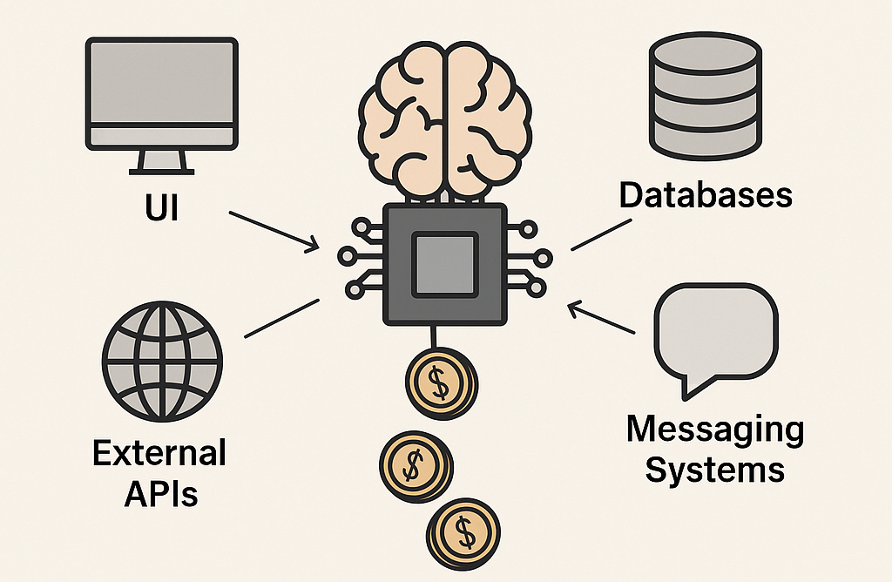
Understanding the Backend in System Design
Where logic lives — and costs emerge
It’s the brain of the system
It bridges other components
It’s usually the most expensive tier
It handles orchestration and decision-making
It defines service boundaries
Notes:
System design starts by identifying components — and making sure each one has a clear responsibility, interface, and contract.

Slide 15
It measures how well your architecture handles growth in:
Users
Data
Requests
Transactions
Introduction to Scalability
Can your system grow with demand?
Notes:
System design starts by identifying components — and making sure each one has a clear responsibility, interface, and contract.

Slide 16
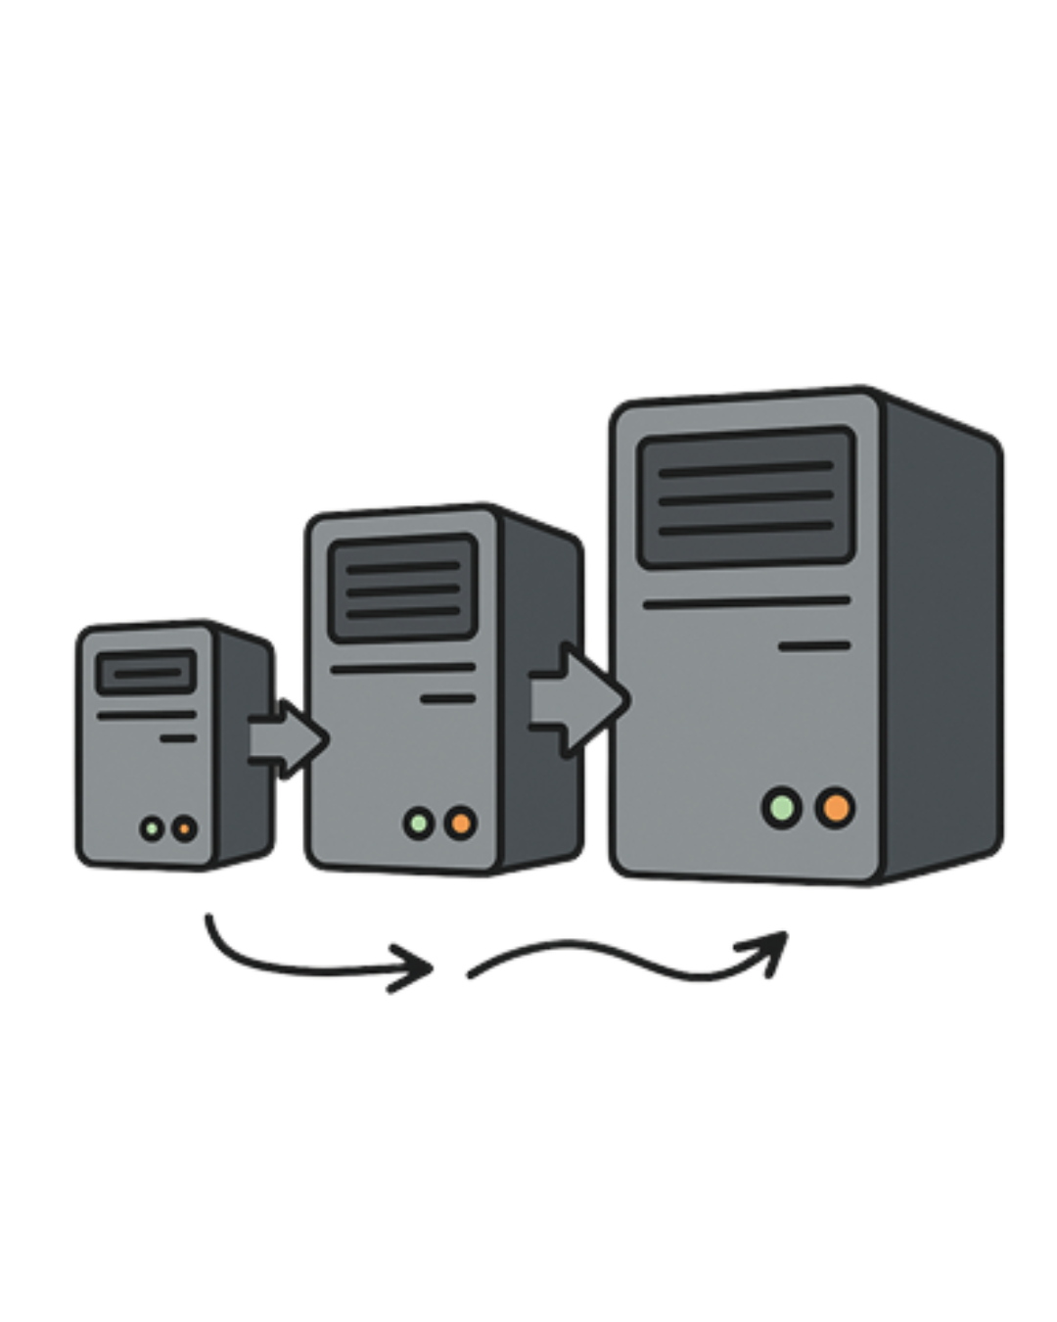
Vertical Scalability
Scale up — not out
Advantages | Disadvantages
Easier setup and maintenance | Hardware limits eventually hit
No need for distributed coordination | Downtime required for upgrades
Can be cheaper in small-scale scenarios | Single point of failure
Supported by most traditional databases | Scaling stops once hardware maxes out
Notes:
System design starts by identifying components — and making sure each one has a clear responsibility, interface, and contract.

Slide 17
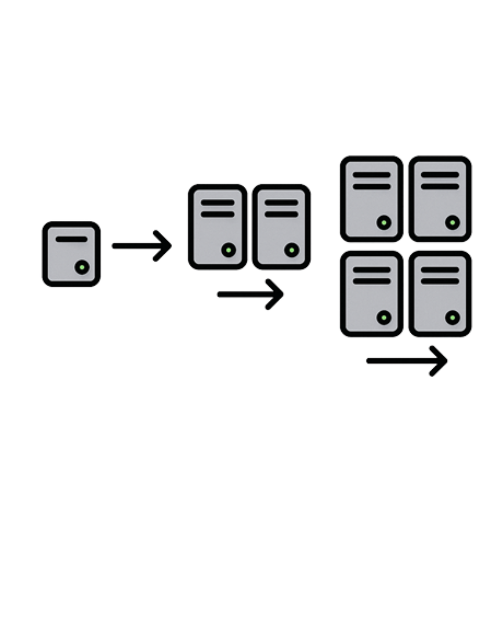
Horizontal Scalability
Scale out — distribute the load
Advantages | Disadvantages
Scales almost indefinitely | More complex to architect and maintain
High fault tolerance | Requires coordination (consistency, replication)
Reduces risk of single point of failure | Load balancers become critical
Ideal for microservices and stateless apps | More moving parts to monitor and secure
Notes:
System design starts by identifying components — and making sure each one has a clear responsibility, interface, and contract.

Slide 18
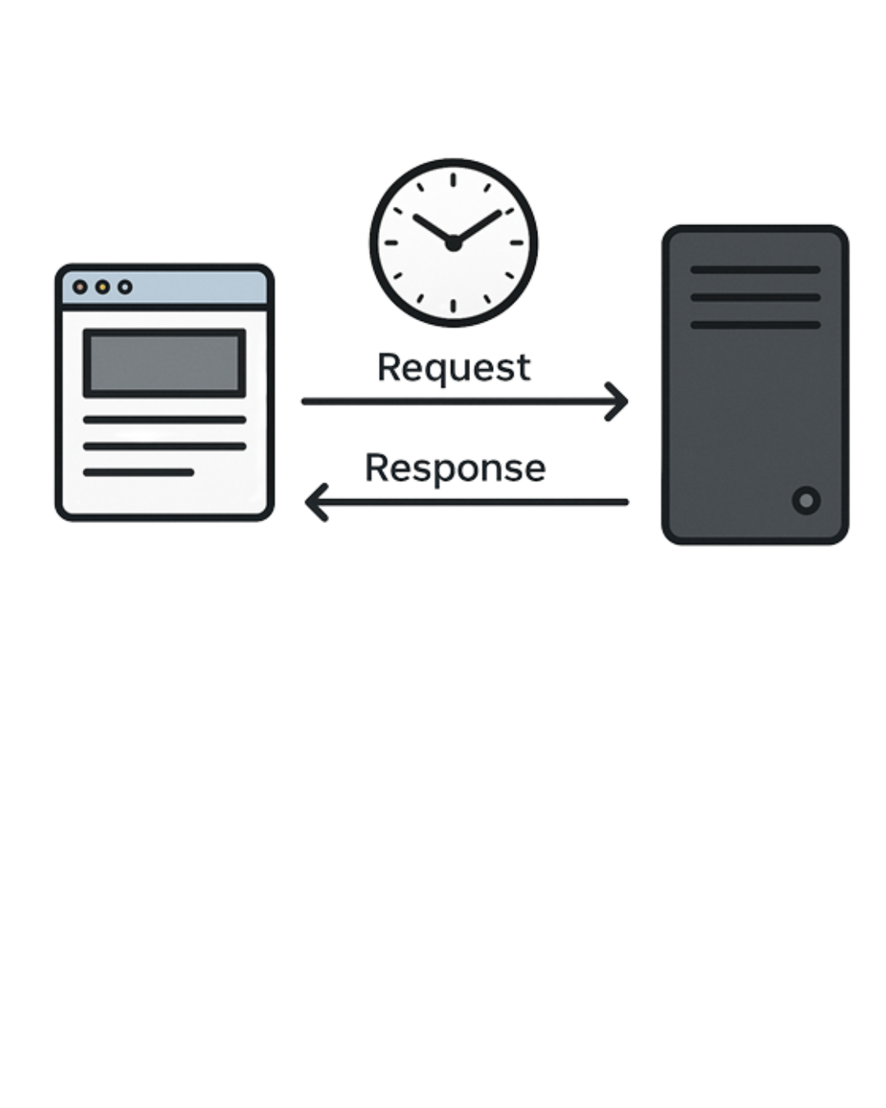
Understanding Latency
The time between action and reaction
Latency is the time it takes for a system to respond to a request.
Measured in milliseconds (ms)
Can be end-to-end, network-only, or application-specific
In user-facing systems, latency defined perceived speed
Notes:
🧠 Sources of Latency
Network delay – physical distance, congestion
Backend processing – business logic, DB queries
Serialization/deserialization – converting data formats
Queueing delays – requests waiting to be served
Client-side rendering – browser-side delays (JS execution)

Slide 19
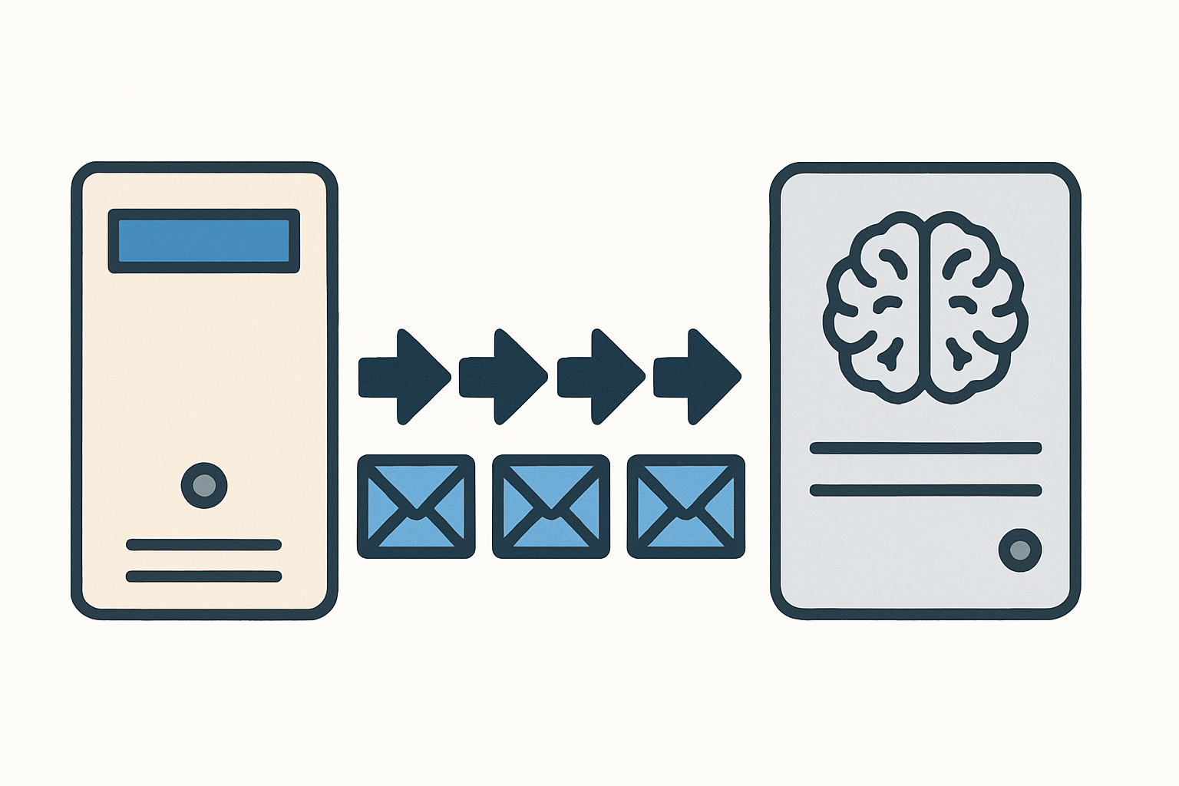
Understanding Throughput
How much work your system can handle
It measures how many operations your system can process in a given time.
Common units:
Requests per second (RPS)
Transactions per minute (TPM)
Jobs per hour
Notes:
🧠 Sources of Latency
Network delay – physical distance, congestion
Backend processing – business logic, DB queries
Serialization/deserialization – converting data formats
Queueing delays – requests waiting to be served
Client-side rendering – browser-side delays (JS execution)

